Slide 1
Goals and Action Recommendations
September 12, 2012

Slide 2
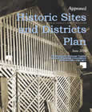
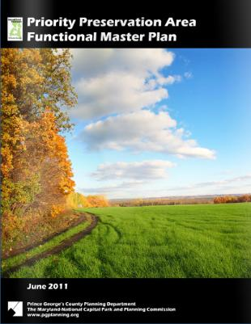
Building on Previous Planning Efforts
Notes:
Need 2010 and Beyond logo

Slide 3
Functional Master Plan Strategic Goals
1 CONNECTIVITY
Connect Prince George’s County residents to quality parks, trails, recreational facilities and programs, and schools. Connect our patrons socially and developmentally to neighborhoods and communities
Example of a Measures
increased trail (miles)
$ ECONOMIC DEVELOPMENT
Contribute to Prince George’s County economy and the financial sustainability of the community.
Example of a Measure
increased property values ( of those close to new/redesign parks or trails)
Y HEALTH AND WELLNESS
Improve the health (physical, mental and environmental) of Prince George’s County residents and promote a wellness ethic for the community as a whole.
Example of a Measures
improved health outcomes

Slide 4
Planning Process
Public, Staff and Executive Outreach and Participation
Functional Organizational Design
Service Classification and Performance Management
Agency Benchmarking on Best Practices
TASKS THAT LAY THE GROUNDWORK:

Slide 5
Planning Process
How Well Recreation Programs Match with Facilities
Facility Needs and Level of Service Assessment
Evaluation of Programs
Facility Space and Design Standards In Place
Indoor and Outdoor Facility Use Assessment
Maintenance Yard and Management Analysis

Slide 6
Planning Process
KEY TASKS THAT INFORM POLICY AND DRIVE SYSTEM DESIGN:
Development of New Facilities Guidelines and Modernizing Standards for Existing Facilities
Land Dedication and Acquisition Processes
Natural and Historic Guidelines

Slide 7
Key Survey Results

Slide 8
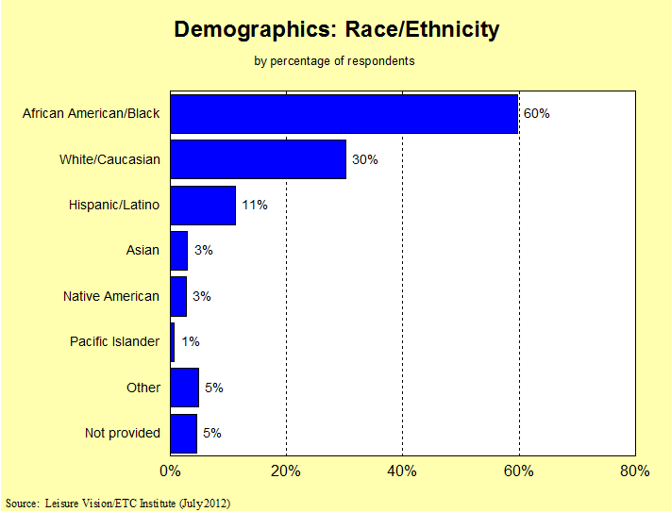

Slide 9
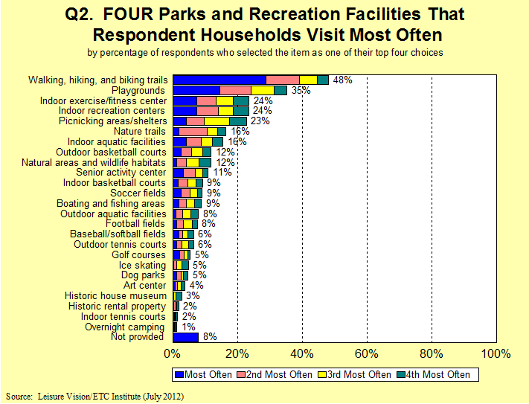

Slide 11
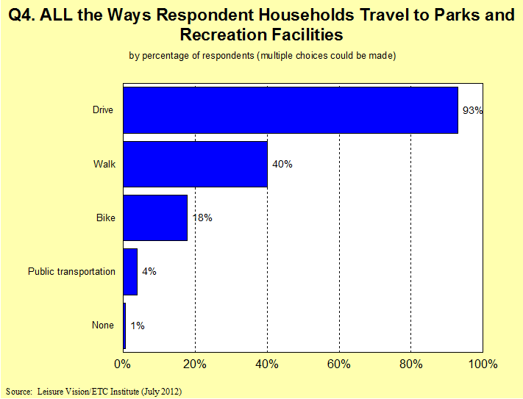

Slide 12
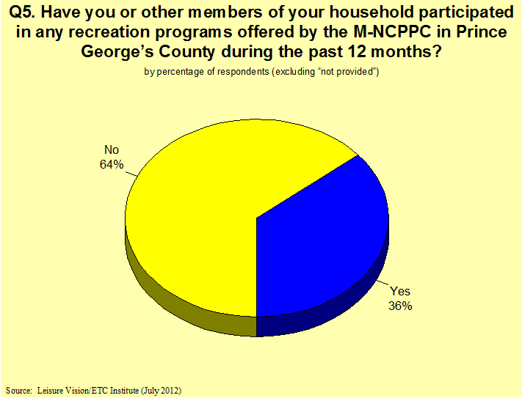

Slide 13
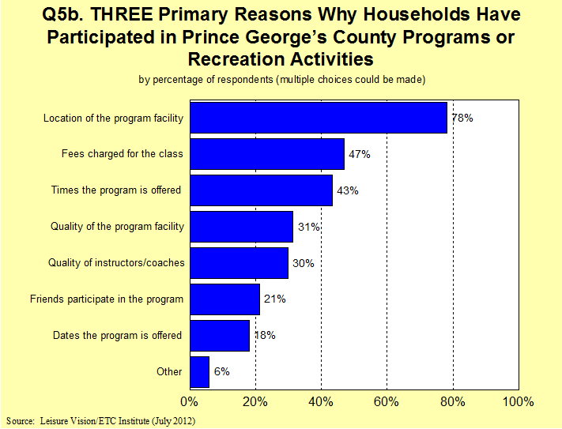

Slide 14
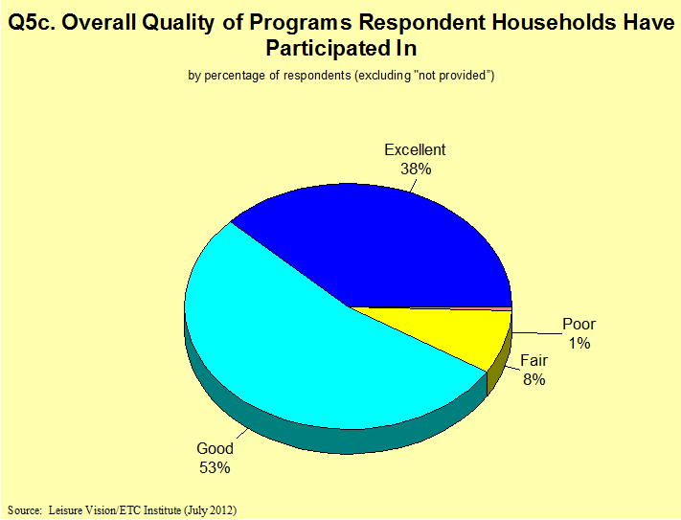

Slide 15
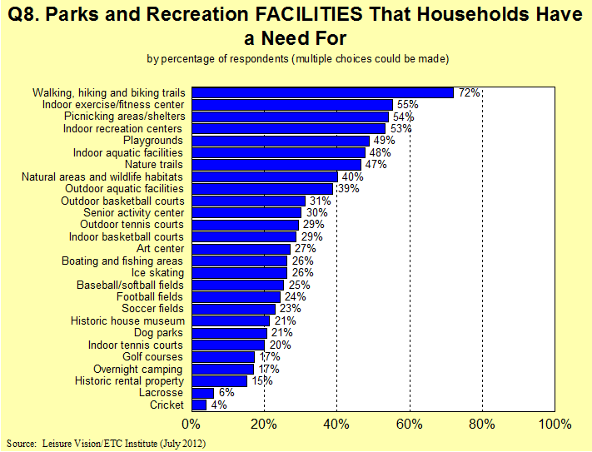

Slide 16
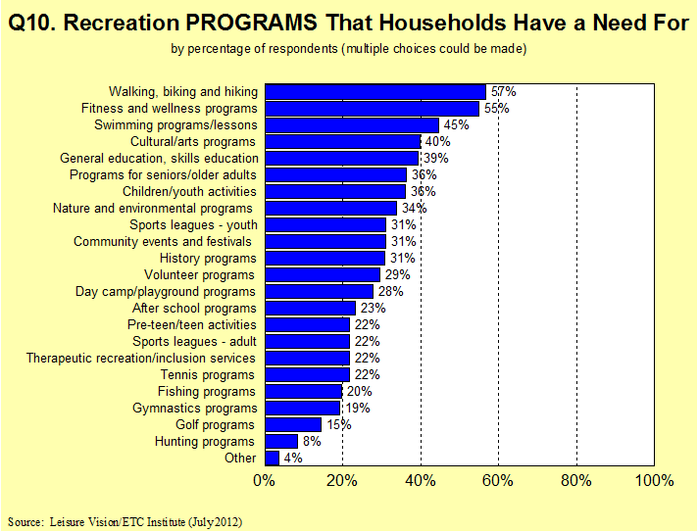

Slide 17
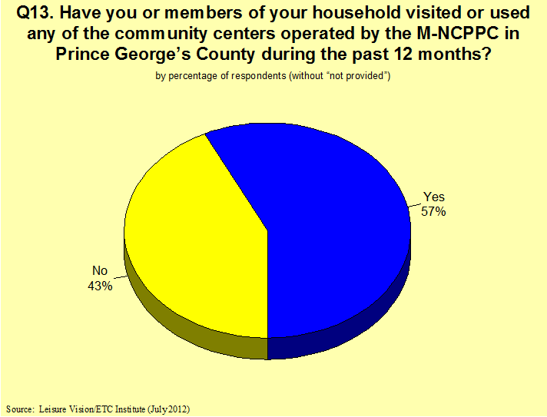

Slide 18
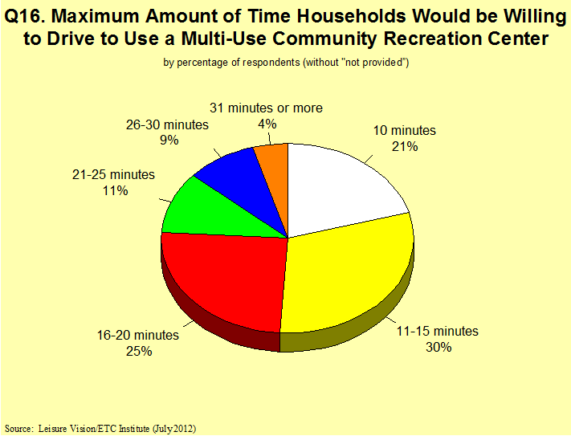

Slide 19
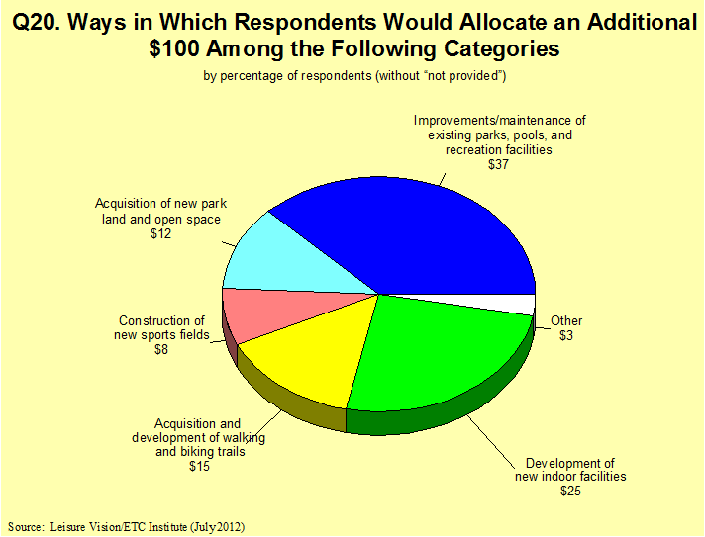

Slide 20
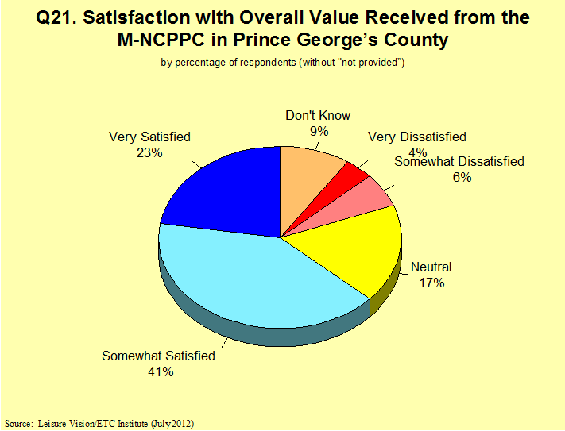

Slide 21
Recommendations
Recommendations

Slide 22
Recommendations: Overall System
Established Facility Locations Standards for:
Developed , developing and rural tiers
Tailor facilities to neighborhood and community conditions
Maintenance/support, e.g. aligned with facility use and condition.

Slide 23
Recommendations: Overall System
Use a comprehensive set of cost/benefit criteria to prioritize capital investments in existing and new facilities and infrastructure
Diversify funding sources outside of taxes through earned income from facilities, foundations/ conservancies, and sponsorships
Develop fair and equitable partnerships

Slide 24
Recommendations: Land
Update Developer Contribution to Park System via “Land Dedication”
Add a tool to increase park and recreation facilities during the development process
Establish an aggressive program to add 200 miles of new trails

Slide 25
Recommendations: Facilities
Maintain What We Have: Establish a policy to set an annual reinvestment of money to protect assets and for preventative maintenance and replacement costs
Create Signature Facilities: Define a vision and criteria for developing one or more signature parks, attractions, and special events
Provide Richer Recreational Experiences: Provide richer recreational experiences for all Prince Georgians through development of larger and sustainable multi- generational facilities and include aquatics as part of the experience

Slide 26
Recommendations: Programs
Establish a System to Identify the level of Tax Subsidy for Program Services
Establish a Pricing Policy to Address Essential, Important and Value Added Services
Tie all programs to connectivity, economic development, and health and wellness goals

Slide 27
Next Steps:
Continue public outreach through 2013
Distribution of the draft plan in February 2013
Public hearing in Spring of 2013
Plan adoption early in 2014
Call 301-699-2255 for information or visit
www.pgparks.com/Formula2040

